Slide 1
FUNCTIONS AND MODULES
PIYUSH VASHISTHA
ASST. PROFESSOR
CEA DEPT.
GLA UNIVERSITY
MATHURA

Slide 2
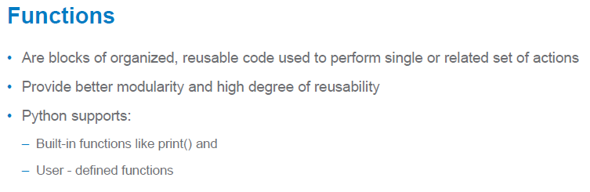
Functions

Slide 3
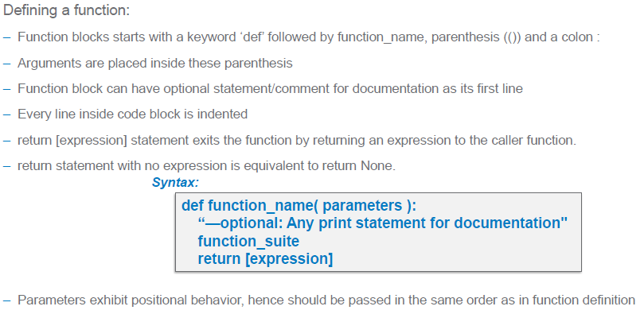
Function Definition

Slide 4
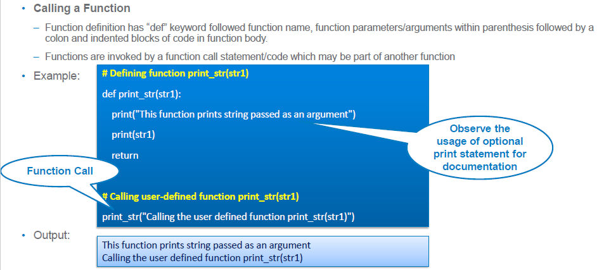
Function Calling

Slide 5
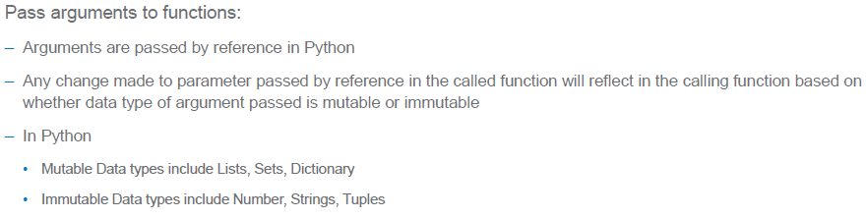
Passing Parameters

Slide 6
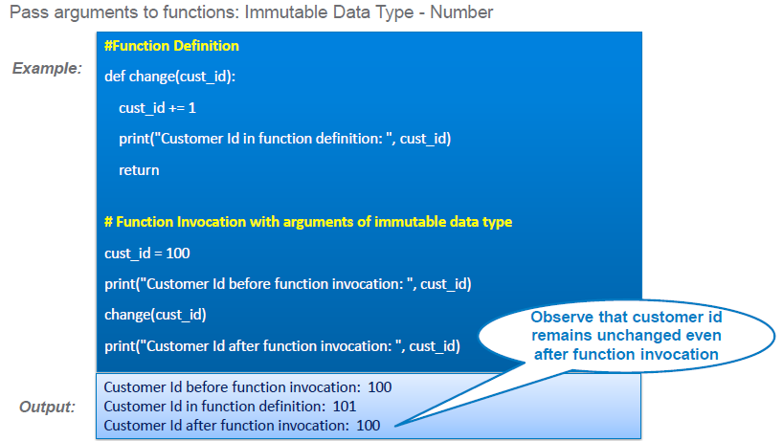

Slide 7
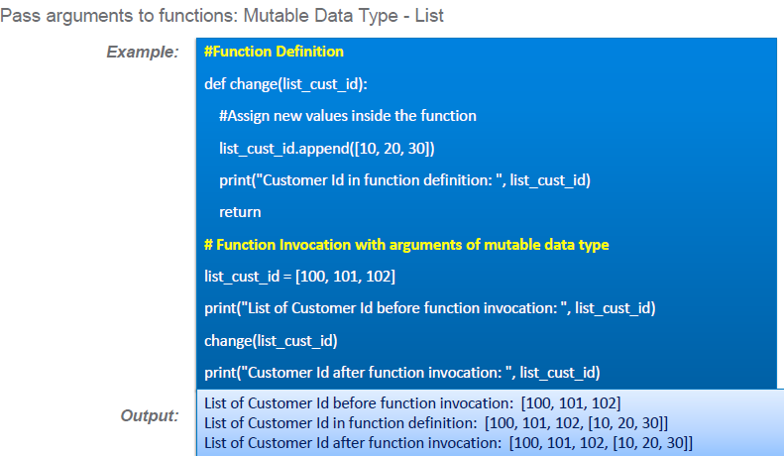

Slide 8
Different types of arguments
Required arguments
Keyword arguments
Default arguments
Variable length arguments

Slide 9
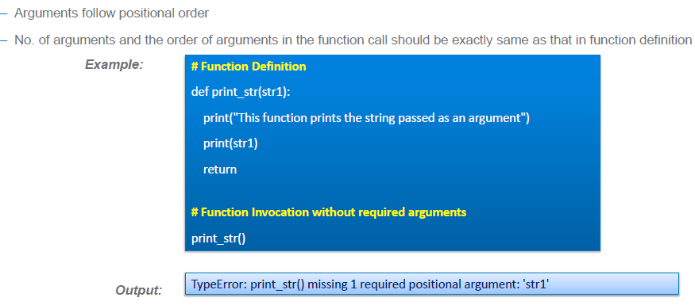
1. Required Arguments

Slide 10
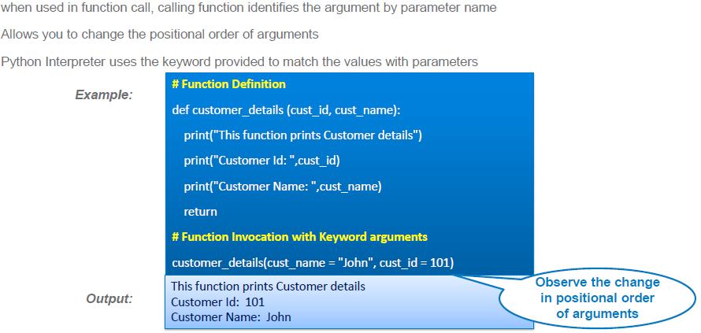
2. Keyword Arguments

Slide 11
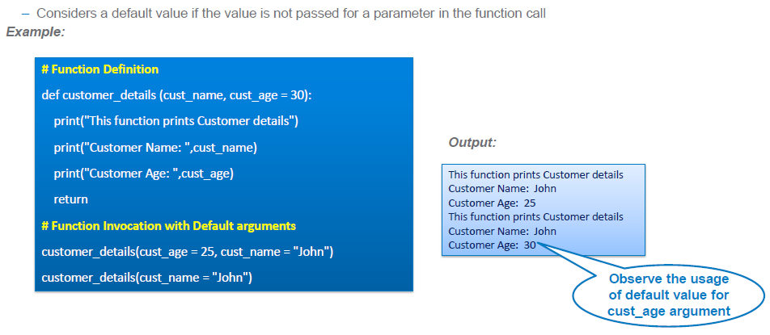
3. Default Arguments

Slide 12
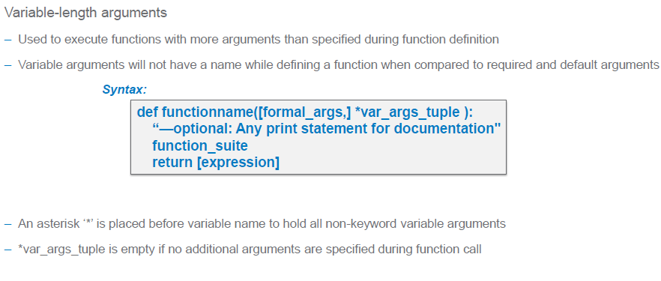
4. Variable-length Arguments

Slide 13
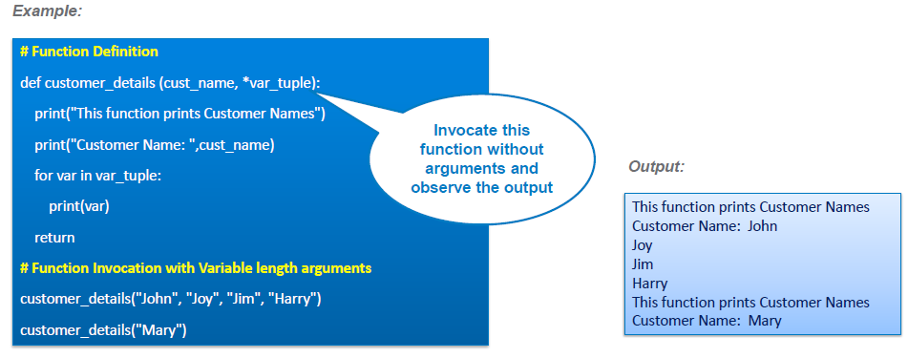
Example

Slide 14
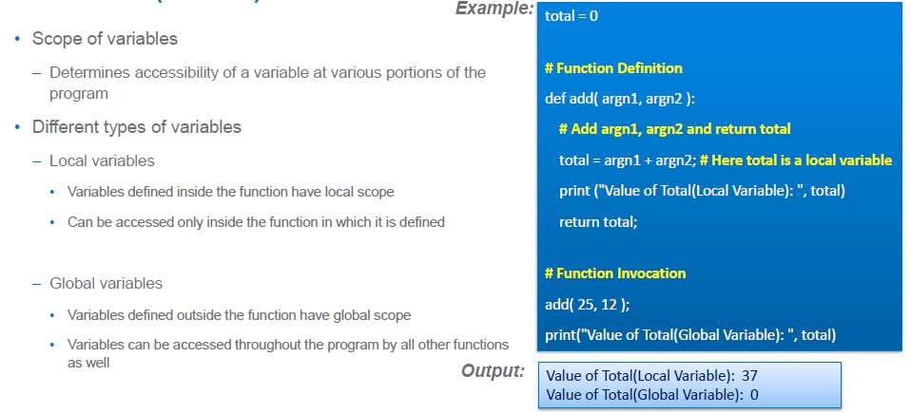
Scope of Variables

Slide 15
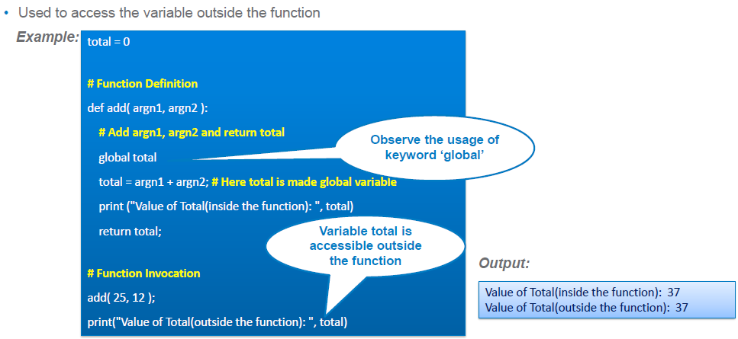

Slide 16
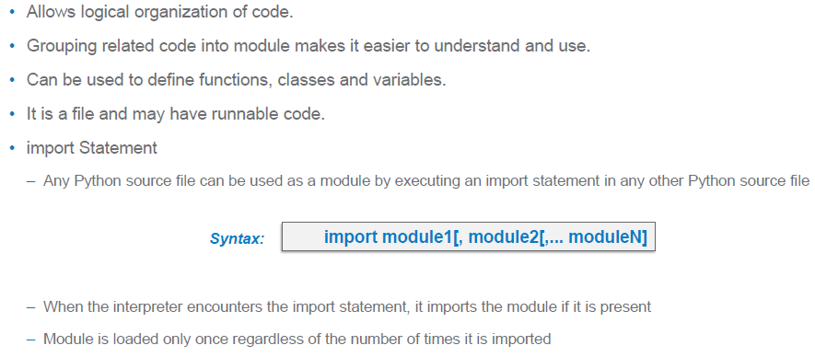
Modules

Slide 17
Some of the modules are:-
math module
random module
time module
datetime module
string module
re module

Slide 18
math Module
math.ceil(x)
math.floor(x)
math.exp(x)
math.sqrt(x)
math.factorial(x)
math.gcd(4,5)
math.hypot(3,4)
math.log(x)
math.log2(x)
math.log10(x)

Slide 19
random module
random.random() Float 0.0<=x<1.0
random.randint(lb,ub) Integer lb<=x<=ub
random.randrange(lb,ub) Integer lb<=x<ub
random.choice(l) l is list or tuple
random.choices(l,weights=v1,k=size)
random.shuffle(l) l is list
random.uniform(lb,ub) Float lb<=x<ub
random.seed()

Slide 20
time module
time.gmtime() Returns current UTC date and time
time.localtime() Returns current local date and time
time.timezone Returns the difference between UTC and local timezone
time.time() Returns the no. of seconds since 1 Jan 1970
time.sleep(n) Suspends execution of current thread for the given number of seconds

Slide 21
datetime module
datetime.datetime.now() Displays current local date and time
datetime.timedelta() Used to add or calculate difference between date and time instances.
print(datetime.datetime.now()+datetime.timedelta(days=10)

Slide 22
string module
string.ascii_letters
string.ascii_lowercase
string.ascii_uppercase
string.digits
string.hexdigits
string.octdigits
string.punctuation

